Slide 1
APP PURCHASING BEHAVIOR
Robert Seybold
Daniel Kim
Anastasia Horvat
Gabby Ruehle

Slide 2




TEAM MEMBERS
Robert Seybold
Daniel Kim
Anastasia Horvat
Gabby Ruehle

Slide 3

Main Finding
While focusing on
Gaming and Entertainment apps may introduce customers into
purchasing apps, developing Professional apps can lead to higher return.
Notes:
Based on final model
identified 7 metrics that were used to predict with __ accuracy if customers have spent money on apps before
We crea
We have identified

Slide 4
AGENDA
01
02
03
EXPLORING THE DATA
MODEL CREATION
RESULTS & RECOMMENDATIONS

Slide 5
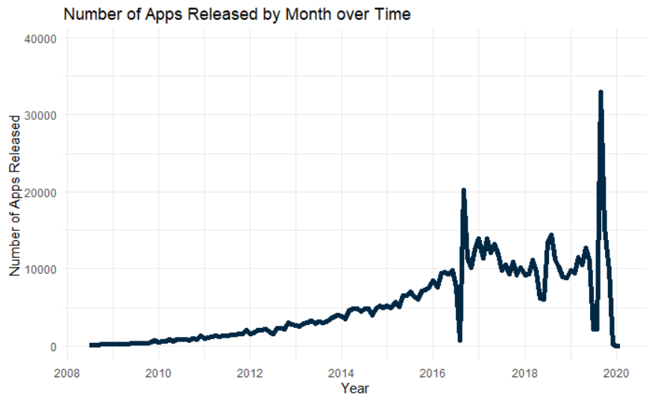
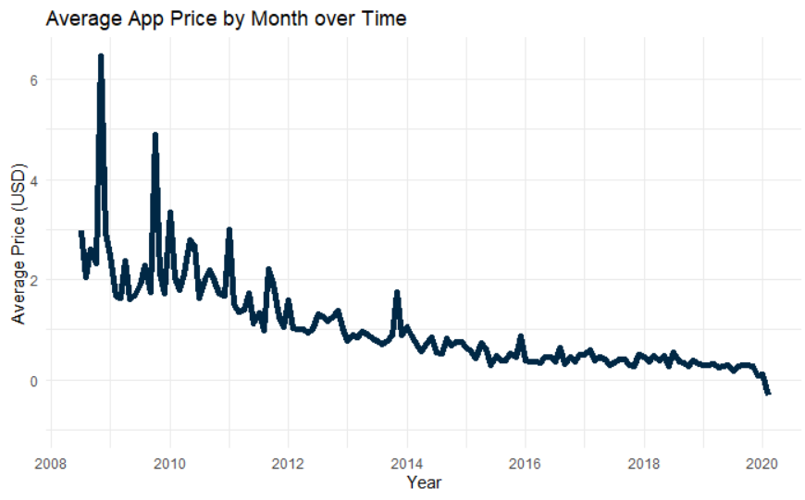
EXPLORING THE DATA
Notes:
Mention used the social media Harvard dataset
Number of Apps Released by Month Over Time
Number of Apps Released by Month over Time

Slide 6
EXPLORING THE DATA
Notes:
Mention used the social media Harvard dataset
Number of Apps Released by Month Over Time
Number of Apps Released by Month over Time

Slide 7
EXPLORING THE DATA
Countries involved in the survey
Notes:
ADD FRANCE AND ITALY TO MAP!!!

Slide 8
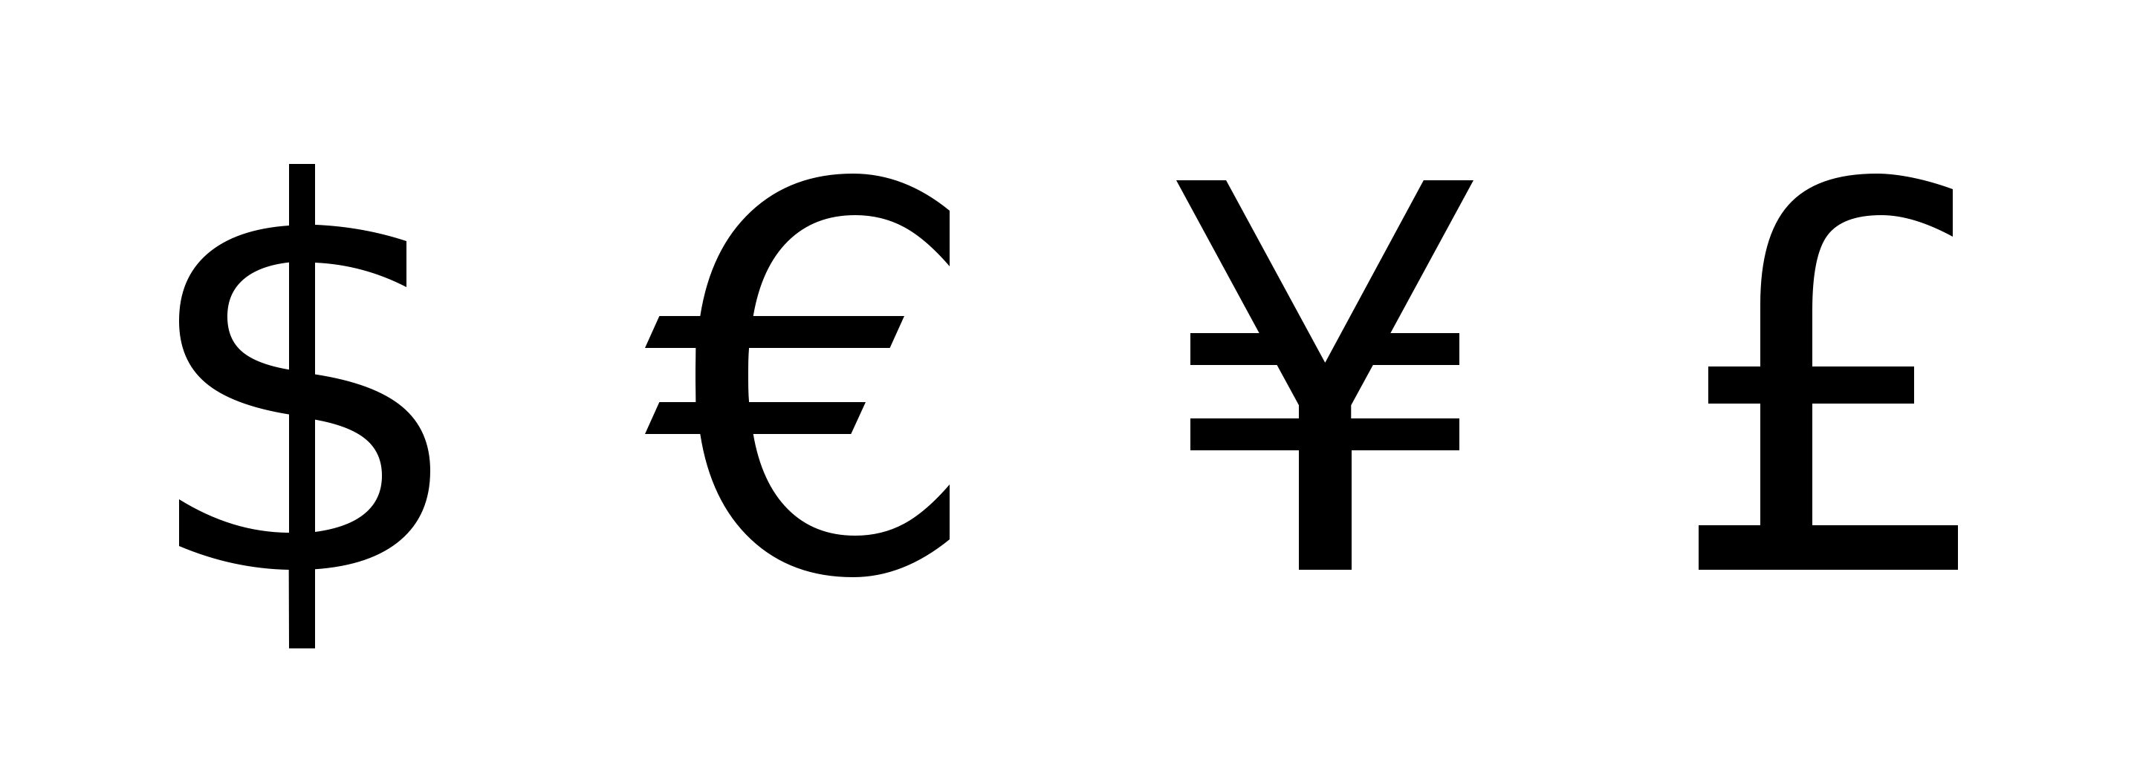
DATA CLEANING
Response Variable: What is the most you have spent on an app? (including in-app purchases such as additional features and subscription)
3.99 CAD
10 POUNDS
$2-$3
50 py6
1200 yen
5.49 euros

Slide 9
MODELING
8.5%
91.5%
27%
30%
43%
Binary
Logistic Regression
Ordinal
Logistic Regression
Notes:
The first model we created was a binary logistic regression, comparing whether or not people spent money on apps.

Slide 10
LOGISTIC REGRESSION
8.5%
91.5%
Binary
Logistic Regression
Notes:
Ana
From this model, We found that 91.5% of people that answered the survey have spent money on apps, whereas the other 8.5 % have not.

Slide 11
LOGISTIC REGRESSION
VARIABLE SELECTION
FINAL MODEL
SIGNIFICANCE
MODEL COMPARISON
Explored significant relationships through Mantel-Haenszel & Chi-Square Tests
Concordance
ROC Curve
Accuracy
Selected best model with best goodness-of-fit
Performed backward elimination and stepwise selection for variable selection
Notes:
Ana
Here is The process of how we built this model :
First , we Used tests such as the mantel haenszel and chi-square test to determine which variables have a significant relationship with spending money on apps
Then we created a number of models using backward elimination and stepwise selection
The various models were then Compared using measures like concordance and accuracy
Lastly Our final model was selected based on whichever had the best goodness of fit , and can be seen in the appendix

Slide 12
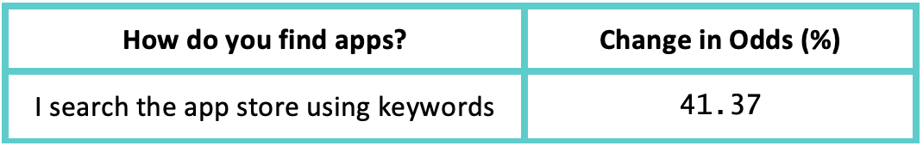
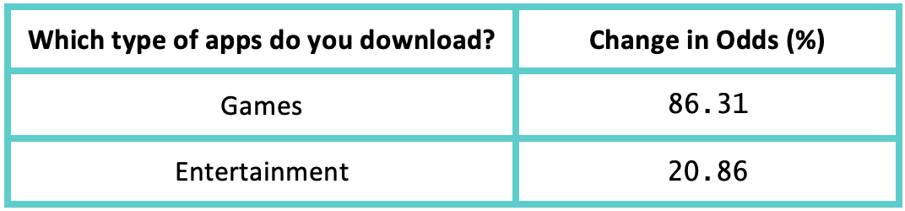
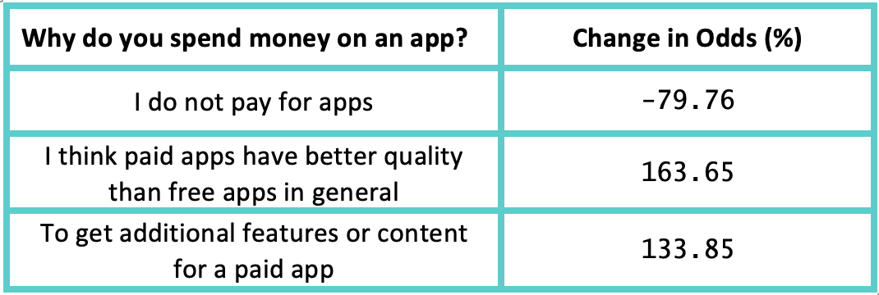
ODDS RATIOS
People that look to download games have 86.31% higher odds to buy apps than those that do not look for games on average.
Accuracy: 75.4%
Notes:
Ana
The final model has an accuracy of 75.4%.
Some key takeaways we found were that people who search the app store using keywords are more like to have spent money on apps.
People that have downloaded game and entertainment apps are more likely to have spent money on apps.
And Lastly, People that have the opinion that paid apps have higher quality and additional features are more likely to have spent money on an

Slide 13
CUMULATIVE LOGIT MODEL
27%
30%
43%
Ordinal
Logistic Regression
Notes:
Target these :
Key word searches
Game and entertainment apps
Apps with higher quality and to remove ads

Slide 14
CUMULATIVE LOGIT MODEL
BIN THE RESPONSE Categorized the amount purchased into 3 bins
CUMULATIVE LOGIT Checked assumptions with Brant Test, then fit Cumulative Logit Model
VARIABLE SELECTION Ran backward elimination and stepwise selection
MODEL SELECTION
Selected model with best goodness-of-fit
Notes:
Target these :
Key word searches
Game and entertainment apps
Apps with higher quality and to remove ads

Slide 15
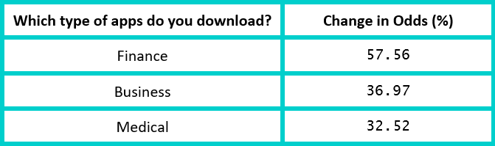
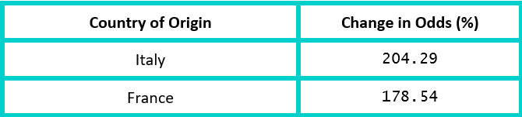
ODDS RATIOS
People that look to download business-related apps have 36.97% higher expected odds of being in a higher maximum amount spent on an app than people who do not download business-related apps.

Slide 16
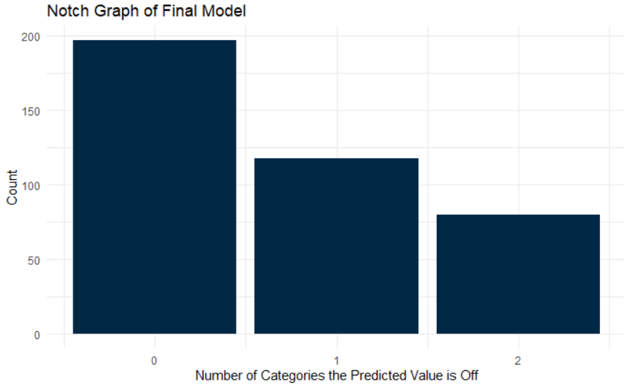
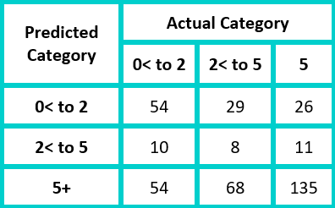
PERFORMANCE

Slide 17
RECOMMENDATIONS
If you want to move into the app development world...
Gaming and Entertainment apps are more likely to be purchased rather than downloaded for free compared to other categories of apps
People who download professional apps are willing to pay more on average
Notes:
Gaming and entertainment apps have a higher chance of being purchased compared to downloaded for free
People who download professional apps are willing to pay more on average

Slide 18
THANK YOU

Slide 19
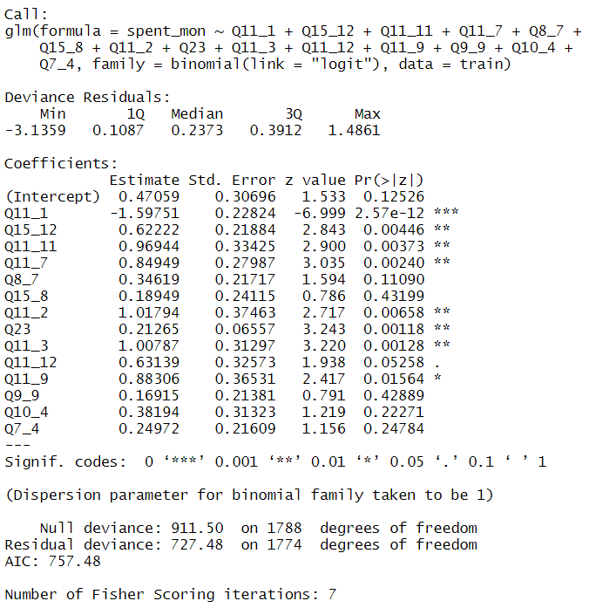
Final Logistic Model

Slide 20
Model Prediction Measures
Concordance: 0.8272056
Discordance: 0.1727944
Coefficient of Discrimination: 0.1355685
KS stat: 0.5200489
KScutoff: 0.9272595
Accuracy: 75.4%

Slide 21
